Slide 1

GOAL SETTING SETTING GOALS AND ACHIEVING GOALS
VIGNAN’S UNIVERSITY

Slide 2
Knowledge helps to reach the destination provided we know what the destination is
Eg: Dronacharya-Arjuna-Bird eye
Unless we focus, we cannot achieve our goal. It is hard to focus and concentrate, but it is a skill that can be learnt

Slide 3
KEEP YOUR EYES ON THE GOAL
People Quit not because they are quitters but because their goal is not insight anywhere.
If the goal is in mind they will accomplish the task

Slide 4
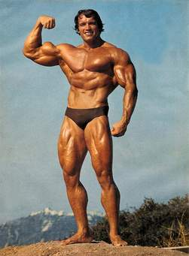
“a committed decision to reach a predetermined specific goal, combined with burning desire, followed by immediate, massive action repeated consistently for as long as it takes until your goal is reached“ Pretty impressive stuff for a guy who started off in a small Austrian town! My point? Determination and perseverance can certainly go a long way Goal setting is not lame or a waste of time! Think about Arnie next time you sit down to write a goals list

Slide 5
Goal Setting: Arnold Schwarzenegger Example
writing his goals on index cards at the beginning of each year
Mr Olympia – he became the youngest ever Mr Olympia at the age of 23
(he’s won the title seven times).
He was a millionaire by the age of 30
He wanted to become a successful Hollywood actor (44+ movies).
He wanted success in politics – he’s the current governor of California and the husband of 26 years to Maria Shriver (related to the Kennedy family).

Slide 6
“a committed decision to reach a predetermined specific goal, combined with burning desire, followed by immediate, massive action repeated consistently for as long as it takes until your goal is reached“.
Pretty impressive stuff for a guy who started off in a small Austrian town! My point? Determination and perseverence can certainly go a long way. Goal setting is not lame or a waste of time! Think about Arnie next time you sit down to write a goals list.

Slide 7
In 1952, Florence attempted to swim the 26 miles between Catalina Island and the California coastline. As she began, she was flanked by small boats that watched for sharks and were prepared to help her if she got hurt or grew tired. After about 15 hours a thick fog set in. Florence began to doubt her ability, and she told her mother, who was in one of the boats, that she didn’t think she could make it. She swam for another hour before asking to be pulled out, unable to see the coastline due to the fog. As she sat in the boat, she found out she had stopped swimming just one mile away from her destination.^{[5]} Two months later, she tried again. The same thick fog set in, but she succeeded in reaching Catalina. She said that she kept a mental image of the shoreline in her mind while she swam. She later swam the Catalina channel on two additional occasions.^{[4]}

Slide 8
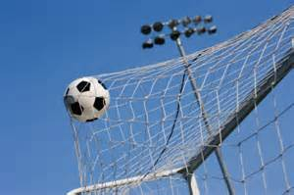
WHY ARE GOALS IMPORTANT?
Goals give direction
Eg: without goal posts how football game can be played?
Why do people go through life without having goals?
Goals motivate us
Goals release hidden potential
Goals improves self image

Slide 9
Great minds have purposes,
others have wishes
- Washington Irving
DREAMS and WISHES are nothing more than desires.
Desires become strong when they are supported by
Direction
Dedication
Determination
Discipline
Deadlines
These are what differentiate from GOALS

Slide 10
HARVARD UNIVESITY STUDY 1979
It is found
89% of the students have no goals
13% have goals, but not written
03% have written goals
After 10 years of study it is found
95% were in high positions
50% reached their goals
10% settled in life

Slide 11
WHY DON’T MORE PEOPLE SET GOALS?
Pessimistic Attitude
Fear of failure
Fear of success
Lack of ambition
A fear of rejection
Procrastination
Low self esteem
Ignorance of importance of goal
Lack of knowledge about goal setting

Slide 12
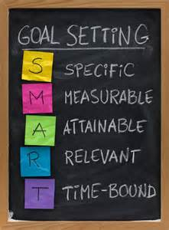
GOALS MUST BE SMART
S-specific
M-Measurable
A-Achievable/Attainable
R-Realistic/Relevant
T-Time-bound

Slide 13
GOALS SHOULD BE SMART
SPECIFIC-When setting goals, they should answer the highly specific questions of who, what, where, when, and why. Instead of the general goal,
"I want to get into MNC”, which job? When? Where? Why?
MEASURABLE- In order for us to track our progress, goals should be quantifiable. "I'm going to get a job" is far more difficult to track and measure than
“ I'm going to get the job around the coming ____ years."

Slide 14
GOALS SHOULD BE SMART
ATTAINABLE- It is important to evaluate your situation honestly and recognize which goals are realistic, and which are a little far-fetched. Instead of, "I am going to be a Collector (while admirable) it might be more realistic to say, "I am going to strive my best to get a decent job“
RELEVENT- Is this goal relevant to your life and to the "big picture" questions you have already asked yourself? Some good questions to ask yourself when figuring this out are:
Does it seem worthwhile?

Slide 15
GOALS SHOULD BE SMART
TIME RELATED- Setting a "due date" to meet goals not only keeps you on track, but it prevents pesky (Troublesome; annoying) daily roadblocks from getting in the way. Instead of saying
"I'm going to get my job", you might consider saying,
"I'm going to get my Job in 4 years."

Slide 16
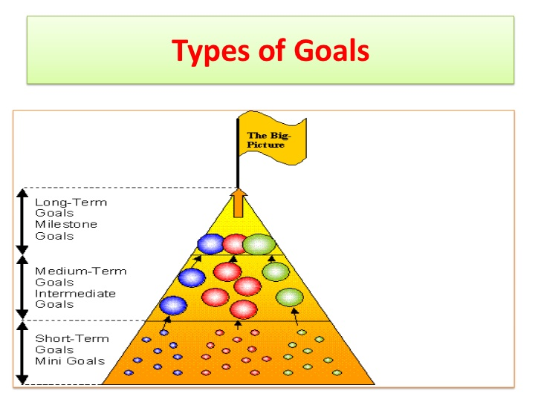

Slide 17
TYPES OF GOALS
Short-term –Upto one year
Mid-term ----Upto three years
Long term----Upto five years
Goals longer than five years is Purpose of life
Goals can be achieved if they are broken into small groups

Slide 18
GOALS MUST BE BALANCED
Our life is a wheel with six spokes
Family
Financial
Physical
Mental
Social
Spiritual
If any of the spokes is out of alignment, life goes out of balance

Slide 19

OUR JOURNEY TO LIFE’S HIGHWAY, KEEP YOUR EYES UPON THE GOAL. FOCUS ON THE DONUT, NOT UPON THE HOLE
- ANONYMOUS

Slide 20

SUCCESS IS A JOURNEY NOT DESTINATION ALL THE BEST
WINNERS DON’T DO DIFFERENT THINGS
THEY DO THINGS DIFFERENTLY

